Slide 1
Demo: Movie Recommendations
Group 4: Alessia Simone, Berk Gönenç, Hannah George, Julia Le, Thorsten Kalb

Slide 2


Obtain data and store it
Download the data from Movielens, look at them and decide to merge together.
Demo: https://files.grouplens.org/datasets/movielens/ml-latest-small.zip
Final: https://files.grouplens.org/datasets/movielens/ml-latest.zip
LINK
MOVIE
RATINGS
TAGS

Slide 3
Merge the data in one table
Only one merged table for all the data.
LINK
MOVIE
RATINGS
TAGS
LINK + MOVIE + RATINGS + TAGS

Slide 4

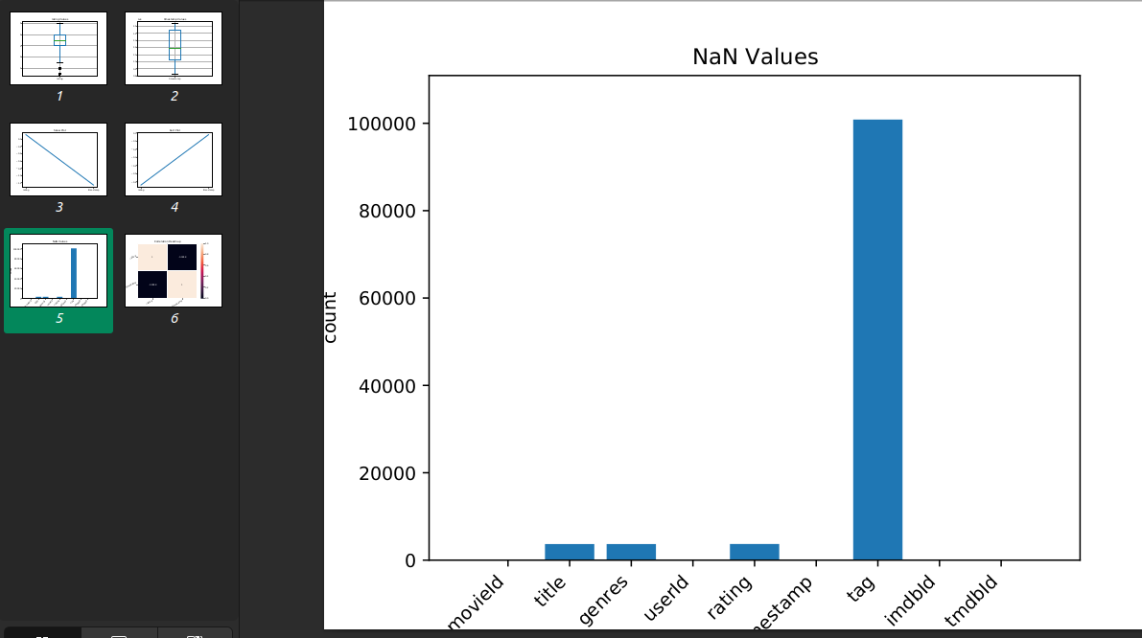
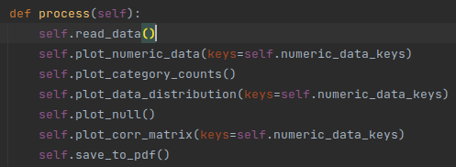
Visualization for the Data Analyst
Plotted
Merged_data
Some code

